Slide 1
FINAL YEAR PROJECT REVEIW
Estimation of Cladding Decay Parameter ‘w’ for Step Index Optical Fibers in Single Mode considering Linearity.

Slide 2
Presented By :
Dipankar Singh 17/ECE/91
Debjit Biswas 17/ECE/92
Biswajit Khan 17/ECE/94
Avinandan Mondal 17/ECE/96
Amit Kumar Mondal 17/ECE/107

Slide 3
Introduction
Optical communication is a communication way with optical wave or pulses of light as carrier.
Light wave gets easily dissipated over atmosphere, thus, optical fibers i.e. glass or plastic is used to contain and guide light waves.
The transmission of data by fiber-optic communication is greatly affected by fiber attenuation, decay and fiber distortion. One of such losses is called Cladding Decay. Also, optical fibers have a considerably higher installation charges.
Both in long haul and short haul installations, there arises a need for a trade-off between the quality and the cost budget.
Traditional method for cladding decay estimation takes costly equipments which are impractical to be used for smaller installations with lower budgets.
In this project, we use an approximation technique, called Chebyshev Approximation Technique, to determine the aforementioned loss approximately with higher precision levels.

Slide 4
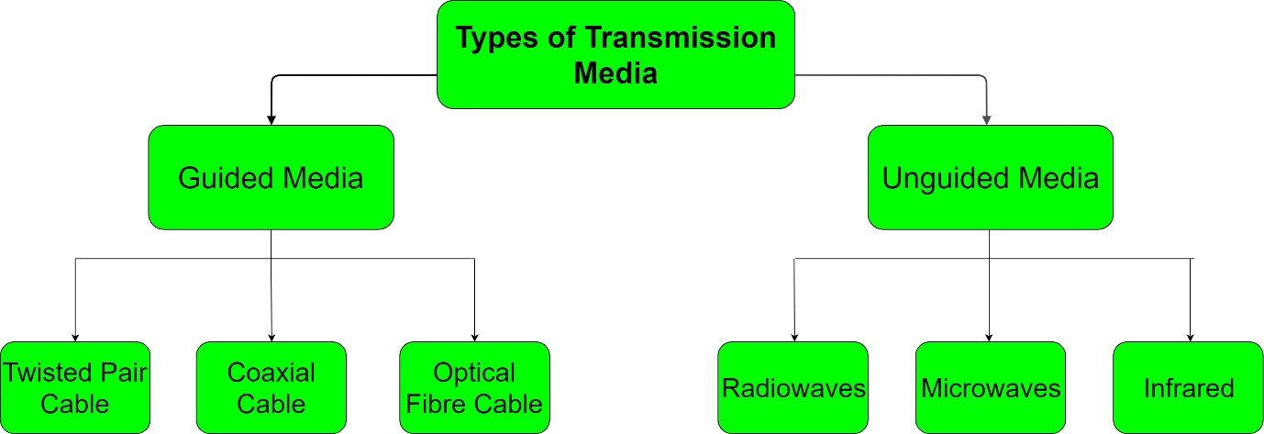
Transmission Medium
Transmission medium is the physical connection or an interface between the transmitter and the receiver.

Slide 5
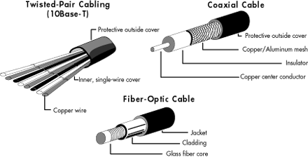
Guided Media :
Guided transmission media are more commonly known as the wired communication or bounded transmission media. The electromagnetic signals travel between the communicating devices through a physical medium/conductor.

Slide 6
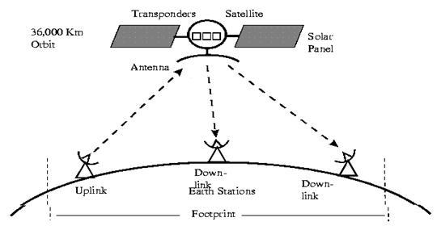
Unguided Media :
The unguided media is also called wireless communication. It does not require any physical medium to transmit electromagnetic signal. In unguided media, the electromagnetic signals are broadcasted through air to everyone and are openly available. They include radio waves, microwaves and infrared.

Slide 7
Optical Fibers
Optical fiber is the technology associated with data transmission using light pulses traveling along with a long fiber which is usually made of plastic or glass.
Optical fibers have an inner core of lower refractive index and outer cladding with higher refractive index.
The fiber optical cable uses the application of total internal reflection of light.
Optical fibers are also unaffected by electromagnetic interference.

Slide 8
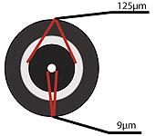
Single Mode fiber optic cable has a small diametral core that allows only one mode of light to propagate. Because of this, the number of light reflections created as the light passes through the core decreases, lowering attenuation and creating the ability for the signal to travel further.
Single Mode Optical Fibers :

Slide 9
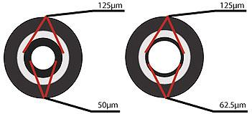
Multi Mode Optical Fibers :
Multimode fiber optic cable has a large diametral core that allows multiple modes of light to propagate. Because of this, the number of light reflections created as the light passes through the core increases, creating the ability for more data to pass through at a given time. Because of the high dispersion and attenuation rate with this type of fiber, the quality of the signal is reduced over long distances.

Slide 10
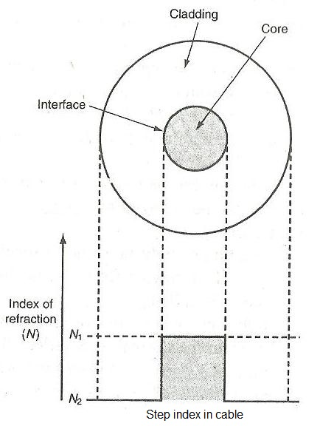
Step Index Optical Fibers :
Step index means sharp step in
the index of refraction between
core and cladding interface. This
indicates that in step index,
core and cladding have their
own constant index of
refractions N1 and N2
respectively.

Slide 11
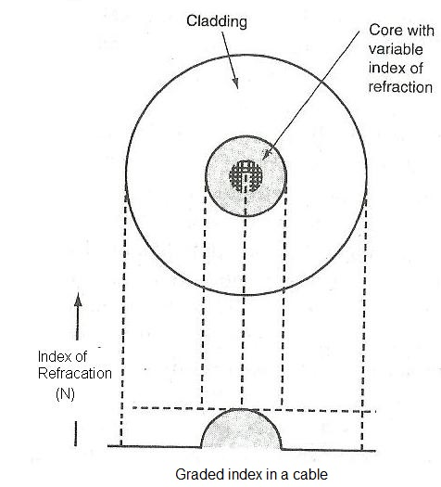
Graded Index Optical Fibers :
In graded index, index of refraction
is not constant but vary smoothly
across the diameter of the core.
Index of refraction is increasing as
one goes near the center while
decreasing near outer core edges.
Index of refraction is maximum at
the center of the core. Index of
refraction is constant for cladding
part of the fiber.

Slide 12
Advantages :
Economical and cost effective
Thin and non-flammable
Less power consumption
Less signal degradation
Flexible and lightweight

Slide 13
Why Single Mode Step Index Fiber is used?
Single Mode cables can propagates signals to larger distances. Given the light source has a narrow spectral width, single mode cables can transmit higher bandwidths.
The single-mode step index fiber has the distinct advantage of low intermodal dispersion.
The external interferences and data dispersion is reduced that limit light scattering and reduce data loss and light waste.
Step Index fibers are cheaper than Graded Index fibers.
f(R) for Single Mode Step Index fibers is equal to 0. This vastly simplifies the calculations and reduces efforts.

Slide 14
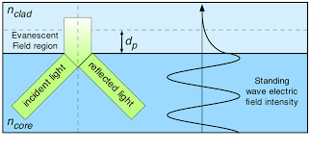
Cladding Decay
The cladding decay occurs when the electric field component interacts with the cladding thereby changing its optical properties, either linearly or non-linearly.
It is one of the most vital losses that determine the usability of a particular optical fiber.

Slide 15
Chebyshev Approximation Technique
It is an approximation numerical technique for solving nonlinear optimal control problems is introduced.
Application of this method results in the transformation of differential and integral expressions into systems of algebraic or transcendental expressions in the Chebyshev coefficients.
By solving the Maxwell's Equation with appropriate boundary conditions, we have derived the equations.
a0 [v2 (1-f(Ri ))-w 2 ] + a2 [4+Ri 2 (v2 (1-f(Ri ))-w 2 ] + a4 [16Ri 2+Ri 4 (V 2 (1-f(Ri )-w 2 )] + a6 [36Ri 4+Ri 6 (V2 (1-f(Ri ))-w 2 ] = 0
for i =1,2,3 (Chebyshev points)
Also,
a0 (αw+β) + a2 (αw+2+β) + a4 (αw+4+ β) + a6 (αw+6+ β) = 0
where, a0 ,a2 ,a4 ,a6 are constants derived from solving Maxwell's Equations with proper boundary conditions
Ri is the Radial Distance from core of the optical fiber.

Slide 16
Advantages :
Low Complexity
Approximation technique that has helped yield results with high precision levels.
The Approximate value is really close to the desired outcome.
The main limitation of this project is low 'V' region (V<1.0) gives considerable amount of errors and when compared with practical experimental techniques.
For the sake of precision, here we are bargaining with the accuracy for a single observation.
Disadvantages :

Slide 17
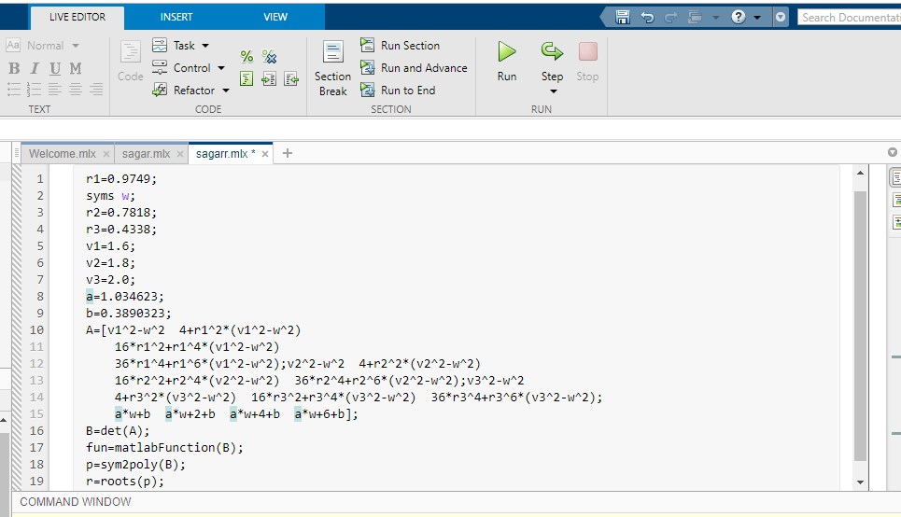
MATLAB Program
(when Linearity is maintained)

Slide 18
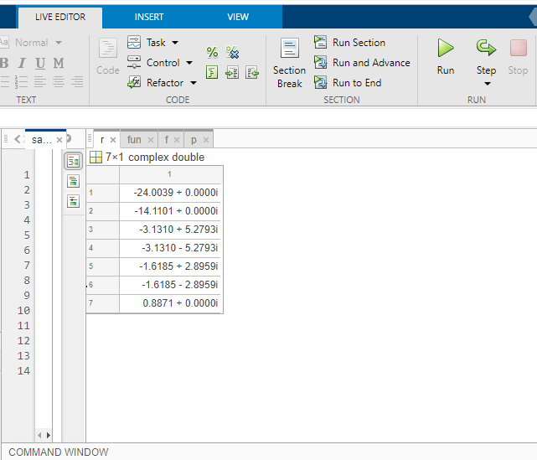
Output

Slide 19
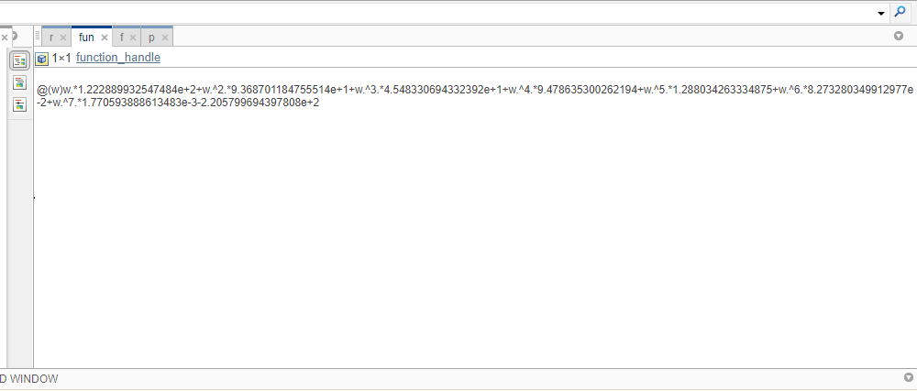
Result
Out of the seven values obtained only one is a real positive integer.
Thus, we can conclude that the Cladding Decay Parameter or ‘w’ is 0.8871

Slide 20
Scope of the Project
This project helps us to estimate the Cladding Decay Parameter in a much uncomplicated way using the Chebyshev Approximation Technique. This technique is much more straightforward than the orthodox methods.
Here, we have estimated the outcome for Single Mode Step Index Optical Fiber that obeys the order of Linearity.
This gives the basic foundation or framework which would help us towards estimating the Cladding Decay Parameter for fibers that do not obey linearity, i.e., losses gradually change over distance.

Slide 21
Thank You

